Slide 1
MSP 430
P.RAJESH
DEPT OF E.C.E
JNTUACEA

Slide 2
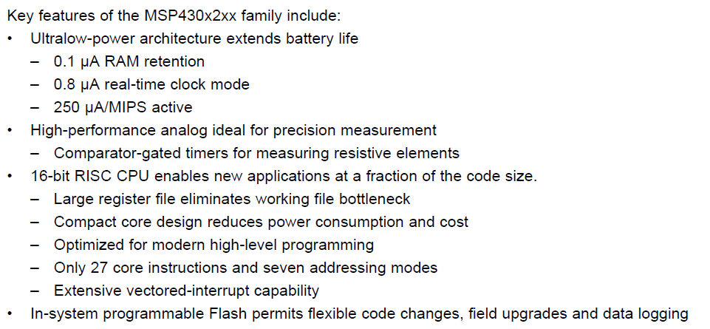
Variants of MSP430

Slide 3
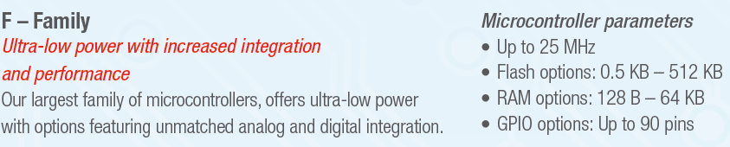
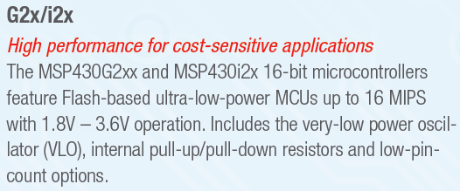

Slide 4
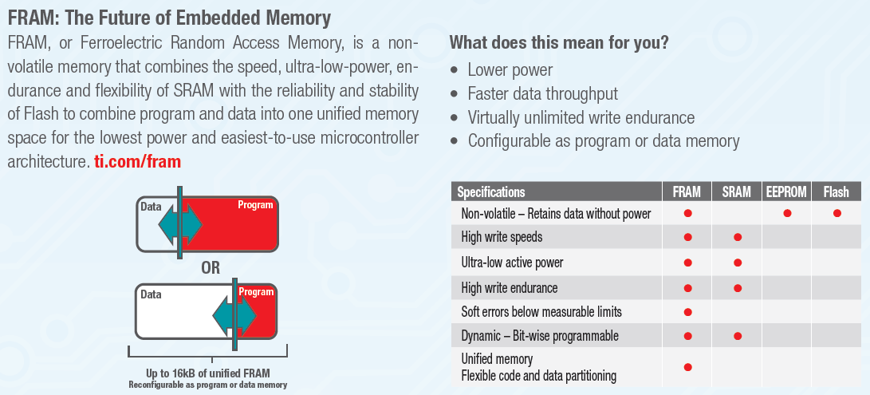

Slide 5
MSP430F2x MCUs
Key Features
Clock
Up to 16 MHz CPU speed
Memory
Up to 120 KB Flash
Up to 8 KB SRAM
Voltage
1.8 – 3.6V operation
Smart Analog and digital
Scan interface
24-bit sigma-delta ADCs
Low power
200 μA / MHz active mode
0.7 μA real-time clock mode/ standby mode
0.1 μA RAM retention
Ultra-fast wake-up from standby mode in <6 μs

Slide 6
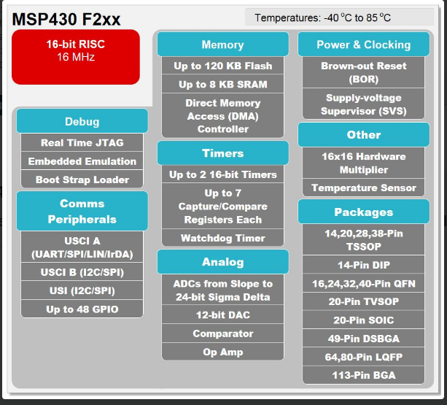

Slide 7
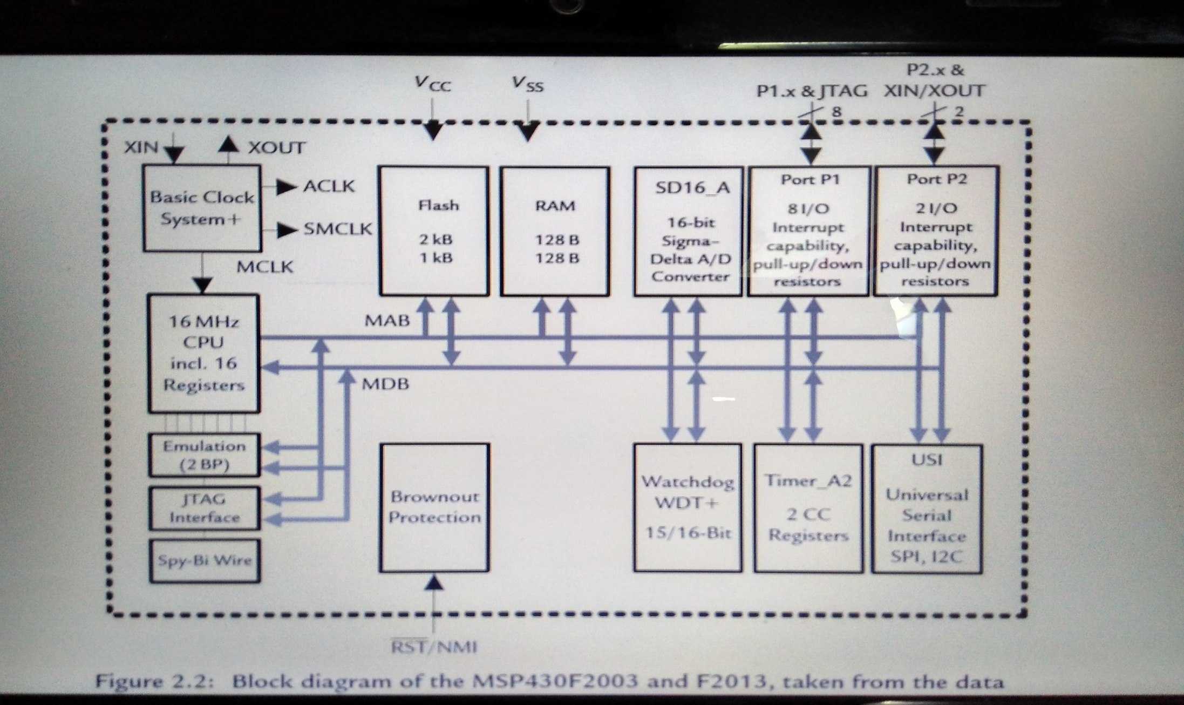

Slide 8
Applications
Metering - Single-phase electronic watt-hour Meter Using MSP430AFE2x (Analog FrondEnd)
Consumer & portable electronics
Transportation/Automotive
Renewable energy
Military/space/avionics
Security & safet

Slide 9
MSP430G2x MCUs
Key Features
Clock
Up to 16 MHz CPU speed
Memory
Up to 56 KB Flash
Up to 4 KB SRAM
Voltage
1.8 – 3.6V operation
Low power
220 μA / MHz active mode
0.7 μA real-time clock mode
0.4 μA standby mode (VLO)
0.1 μA RAM retention
Ultra-fast wake-up From standby mode in <1 μs

Slide 10
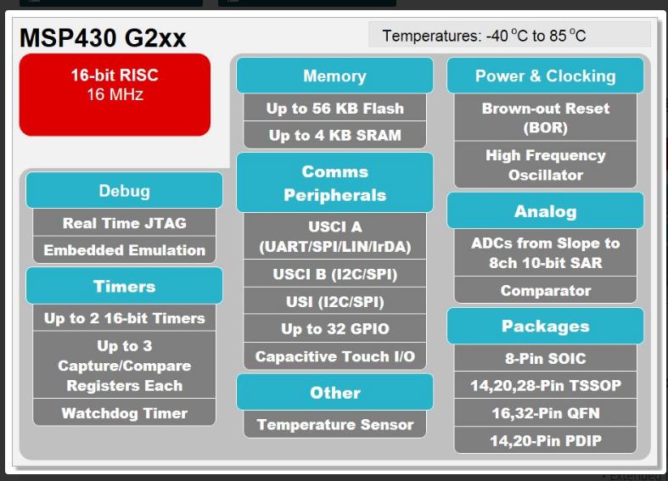

Slide 11
Applications
Capacitive touch
Industrial
Safety and security
Extended temp
Transportation/automotive
Military/space/avionics
Renewable energy

Slide 12
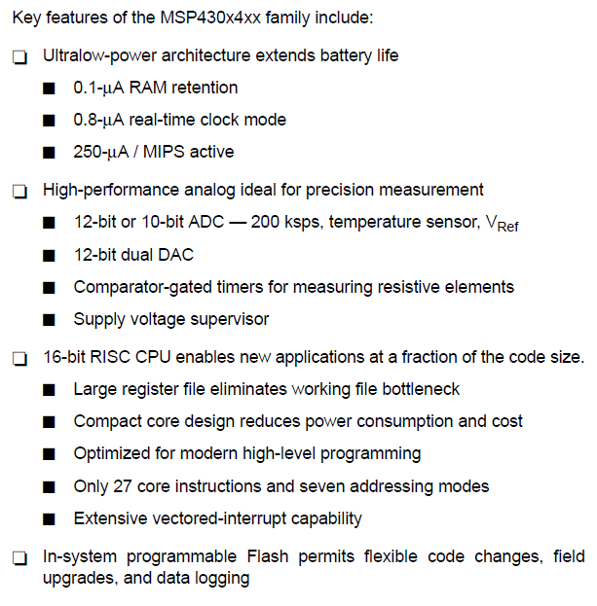

Slide 13
Key Features of MSP430F4x MCUs
Clock
Up to 16 MHz CPU speed
Memory
Up to 120 KB Flash
Up to 8 KB SRAM
Voltage
1.8 – 3.6V operation
LCD
Features integrated LCD controller
Smart Analog and digital
Wide range of high-performance analog and intelligent digital peripherals
Low power
200 μA / MHz active mode
0.7 μA real-time clock mode
0.1 μA RAM retention
Ultra-fast wake-up from standby mode in <6 μs

Slide 14
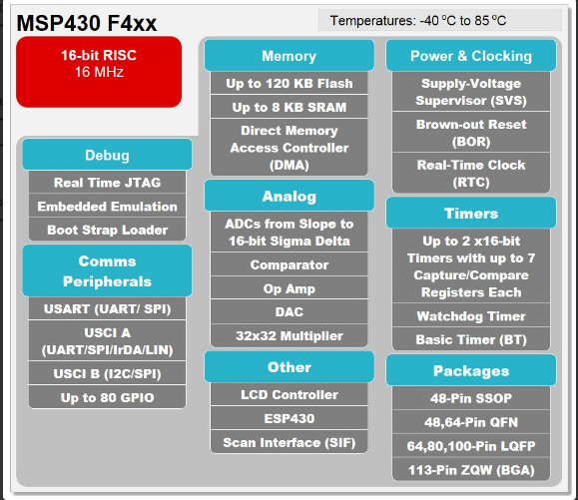

Slide 15
Applications
Metering
Portable medical

Slide 16
F5xx Key Features
Ultra-Low Power
160 μA in active mode
2.5 μA standby mode
Integrated LDO, BOR, WDT+, RTC
12 MHz @ 1.8V
Wake up from standby in <5 μs
Increased Performance
Up to 25 MHz
Up to 512 KB Flash
Up to 66 KB RAM
1.8V ISP Flash erase and write
Fail-safe, flexible clocking system
User-defined Bootstrap Loader
Up to 1MB linear memory addressing
Innovative Features
Multi-channel DMA supports data movement in standby mode
Industry leading code density
More design options including USB, RF, encryption, LCD interface
Notes:
The MSP430F5xx is the next generation technology platform for the MSP430 family and continues to expand on MSP430’s industry leadership in the ultra-low-power 16-bit MCU space. The 5xx family offers improved ultra-low-power performance with innovative new power conserving features such as adjustable core voltage and an integrated low-power LDO. Cutting edge power efficiency is available through an innovative power management system as well as record breaking performance at 160 µA/MIPS with 256-KB flash and 16-KB RAM. The 5xx also offers increased peripheral performance, significantly higher levels of integration and many new features designed for customer ease of use, all while remaining completely compatible with existing MSP430 families.

Slide 17
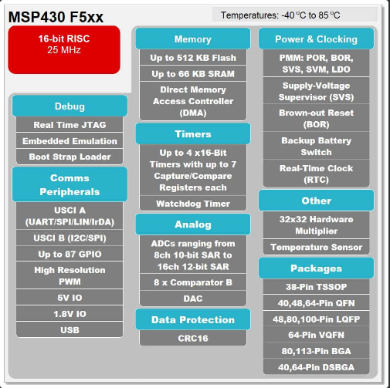

Slide 18
Applications
USB
Consumer & portable electronics
Portable medical
Test and measurement

Slide 19
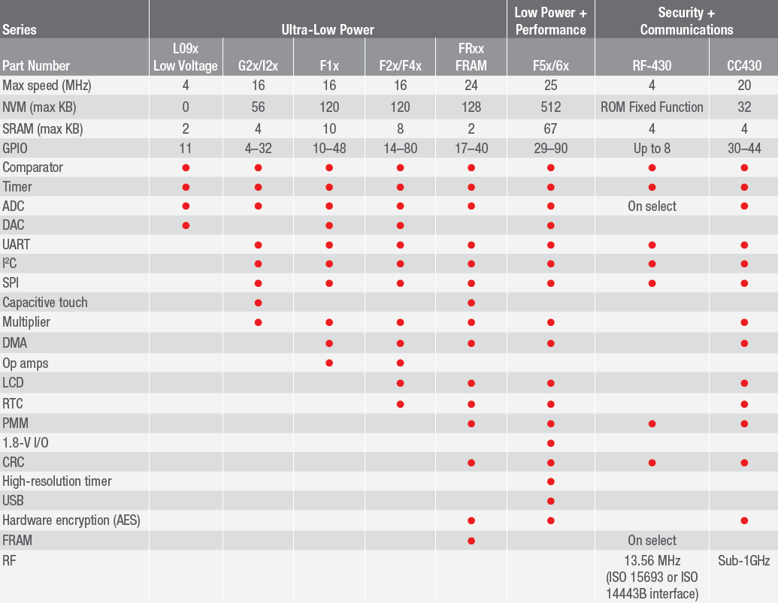
MSP430 Families
Low Power + Performance
Ultra Low Power
Security + Comm

Slide 20
MSP430 Peripheral Overview
2xx | 4xx | 5xx | FR5xx
Basic Clock System + | FLL, FLL+ | Unified Clock System
Core voltage same as supply voltage (1.8-3.6V) | Core voltage same as supply voltage (1.8-3.6V) | Programmable core voltage with integrated PMM (1.8-3.6V)
GPIO w/ pull-up and pull-down | GPIO | GPIO w/pull-up and pull-down, drive strength
N/A | LCD Controller | CRC16 | CRC16, AES256
Software RTC | Software RTC with Basic Timer, Basic Timer + RTC | True 32-bit RTC w/Alarms | True 32-bit RTC w/Alarms
USCI, USI | USART, USCI | USCI, USB, RF | eUSCI
DMA up to 3-ch | DMA up to 3-ch | DMA up to 8-ch
MPY16 | MPY16, MPY32 | MPY32
ADC10,12, SD16 | ADC12, SD16, OPA | ADC12_A
4-wire JTAG (2-wire on some dev’s) | 4-wire JTAG | 4-wire JTAG, 2-wire Spy Bi-Wire | 4-wire JTAG, 2-wire Spy Bi-Wire
Notes:
UCS – Compare this with the clock system of the past MSP430 devices. With this clock system you can pretty much connect any clock source to any of the clock nets driving the CPU and peripherals (MCLK, ACLK, SMCLK) with more FLL reference capability. A low power, low frequency oscillator has been added that has low accuracy and runs at 12KHz. Good for non-critical applications.
Power Management Module (PMM)- Programmable core voltage conserves power when the CPU frequency can be reduced for the application. Keep in mind there are some external LDOs from TI that allow you to change the output voltage as well for the older devices without the PMM.
CPU – still a 16 bit core but no paging for the extended addressing. Core frequency is also increased.
The GPIO is more flexible/capable with the 5xx devices with pull-ups/downs and programmable drive strength. I/Os can be 16 bits wide when combined and also provide interrupt capability.
The CRC module has been added and is a separate module. This is a nice feature because it can be used with any peripheral. Compare this with some competing devices where the CRC is integrated with say the SPI module or something.
No more software overhead to wake up and perform the RTC function. The 5xx has this as a 32 bit counter. Can also be used as an interval timer.
USB will be added in future devices. This is new for the MSP430 family.
DMA channel capability has been increased to 7. This is device dependent. For example, the F5438 has three channels.
MPY32 – 32 bit operands with a 64 bit result via 4 output registers. Retains backwards compatibility with the lower results registers.
ADC12_A – This is a much lower power ADC now (150µA instead of the 800µA from the 44x ADC). A big improvement is also the reference settling time. The old 44x reference stabilized in 17ms. The new reference is stable in 35us. A huge improvement.
JTAG – all 5xx devices will include a dedicated JTAG port (PJ) that will support both 4-wire JTAG and 2-wire Spy Bi-wire. Unused pins maybe used as general GPIO.

Slide 21
MSP430™ Series Comparison
Mode |  | G2xx | F5xx | FR57xx | FR58xx FR59xx
Performance (max) |  | 16 MHz | 25 MHz | 24 MHz (FRAM at 8MHz) | 16 MHz (FRAM at 8MHz)
Flex Unified Memory |  | No | No | FRAM (16K) | FRAM (64K)
Active | AM | 230 µA (1MHz) | 180 µA/MHz | 100 µA/MHz | <100 µA/MHz
Standby RTC | LPM3 | 0.7 µA | 1.9 µA 2.1 µA | 6.3 µA 1.5 µA | 0.7 µA 0.4 µA
RAM Retention mode | LPM4 | 0.1 µA | 1.1 µA 0.2 µA | 5.9 µA 0.3 µA | 0.6 µA 0.1 µA
Wake-up from | Standby | 1.5 µs | 3.5 µs or 150 µs | 78 µs | <10 µs

Slide 22
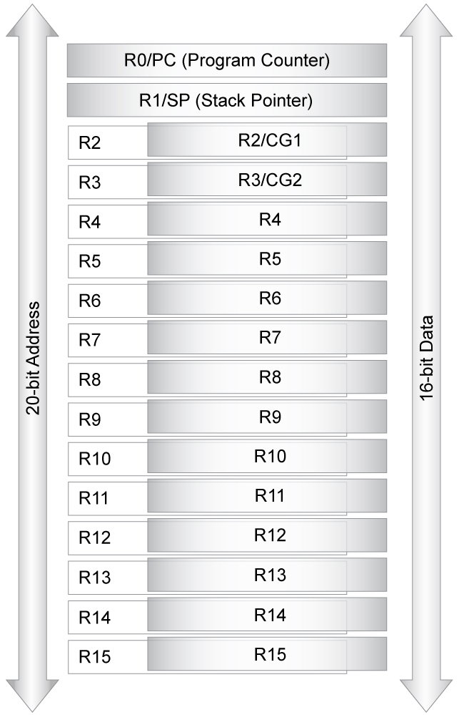
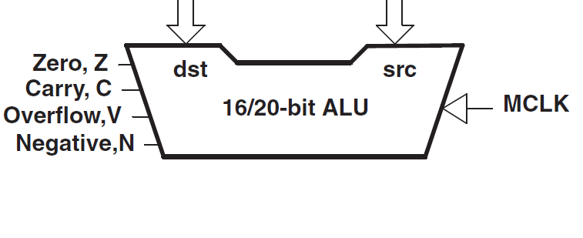
MSP430 CPU
Efficient, ultra-low power CPU
C-compiler friendly
RISC architecture
51 instructions
7 addressing modes
Constant generator
Single-cycle register operations
Bit, byte and word processing
1MB unified memory map
No paging
Extended addressing modes
Page-free 20-bit reach
Improved code density
Faster execution
100% code compatible with earlier versions
Notes:
Modern 16-bit RISC CPU is optimized for modern programming techniques.
The MSP430’s architecture provides the flexibility of 16 fully addressable, single-cycle 16-bit CPU registers. The large CPU register file eliminates what is typically a single working file or accumulator bottleneck. The CPU registers are fully accessible including the program counter, stack pointer, status register and 12 working registers.
The CPU also integrates a constant generator to automatically generate the six most used immediate values. The constant generator has the effect of reducing code size by generator this common constants (or literals) using hardware, eliminating what would be immediate values embedded in code.
The modern Reduced Instruction Set (RISC) design of the CPU offers versatility through simplicity using only 27 easy-to-understand instructions and seven consistent addressing modes. All memory spaces – Flash, RAM, peripherals and CPU registers - use the exact same instructions and addressing modes. All instructions can also be used in a byte format as well. The MSP430 is an orthogonal design because all instructions are used consistently though all areas of the device.
Up to 8 MIPS of performance is available today, with more planned.
The result is a 16-bit, ultra-low power CPU that has more effective processing throughput, is smaller in size, and more code-efficient than other 8/16-bit microcontrollers. When using the MSP430, this results in programmers writing less lines of code. Now it’s possible to develop ultra-low power, high-performance applications at a fraction of the code size previously possible.

Slide 23
Unified Memory Map/Address space
In-System Prog (ISP)
Write using: User program, JTAG, BSL
Byte, word, long-word
Erase one (or all) segments at a time
‘F5529 Memory Map
0xFFFF | Flash | 128K
0xFF80 | INT Vectors | 80
0x2400 | RAM | 8K
0x01C0 | USB RAM | 2K
 | Info Memory | 512
 | Boot Loader | 2K
0x0000 | Peripherals | 4K
MSP430 Memory
Unified memory map (program or data)
Absolutely no paging
Bytes
Main Flash
512 byte segments
Start address moves according to RAM
RAM
Always a contig. block
If enabled, USB port uses first 2K
RAM segments can be powered down
Info Memory
Use for your own calibration data, etc.
4 segments (A-D)
128 byte segments
Boot Loader (BSL)
Program Flash/RAM with serial (slau319)
Password protected
512 byte segments
Device Descriptors (TLV)
Factory calibration data, periph support,…
Found in peripherals (at 0x1A00)
Notes:
The MSP430 uses a single unified memory address map for code, data and peripherals. There is absolutely no paging with direct access to program and data anywhere throughout the entire address space which include Flash, ROM RAM and peripherals with no restrictions. Support for agile unrestricted code including branching, subroutine calls, function calls and interrupts are supported. All of the Flash and RAM memory can be addressed as either 8-bit bytes or 16-bit words.
Peripheral module address are collected below 0x200. The complete instruction set and all addressing modes can be used to with peripherals.
Flash is segmented into 512B main memory segments. Additional smaller information memory segments are also available. The only difference between main and information memory is size – code and data can be located anywhere. The total number of main memory segments depends on the device - for example, a 4KB device has eight main memory segments.
Flash memory operates from 1.8V – 3.6V. Programming/erase voltage is 2.7V (reduced to 2.2V on 2xx). Flash can be erased and reprogrammed 100k times with 100 year data retention typical. 60kB of Flash can be programmed in as fast as 2 seconds.
There are three methods of programming Flash; Out or in-system using JTAG, a Bootstrap Loader (BSL) or in system using normal software. The bootstrap loader is a section of ROM code that resides on the device itself and allows communication using a common 9600 baud UART protocol. Information regarding the BSL is also available on the MSP430 website.
The sequence to program Flash is very easy with timing controlled by hardware. For security reasons, Flash can not be programmed or erased unless a password is used when the Flash control registers are accessed.During programming and erase program execution is automatically halted. After the operation software resumes with the next instruction and any enabled interrupts that occurred during the programming or erase operation are automatically serviced.

Slide 24
Memory Maps
‘F5529
0xFFFF | Main Flash | 81K
0xFF80 | INT Vectors
0x4400 | Main Flash
0x2400 | RAM
0x1C00 | USB RAM
0x1A00 | TLV
 | Info A
 | Info B
 | Info C
0x1800 | Info D
 | Boot Loader
0x0000 | Peripherals
0x243FF
‘FR5969
Main FRAM | 17K
INT Vectors | 80
Main FRAM | 47K
Vacant | 8K
RAM | 2K
TLV
Info A | 128
Info B | 128
Info C | 128
Info D | 128
Boot Loader | 2K
Peripherals | 4K
Most MSP430 devices have similar Memory Maps
Devices use Flash or FRAM for non-volatile storage:
Main is commonly used for:
Program code
Large constant arrays/structs
TLV Device Descriptor lets your program access device features (data stored in tag-length-value format)
Info user memory
Used for non-volatile variables and calibration data
Broken into four 128-btye segments: Info A-D
Flash requires entire segment to be erased – no restrictions for FRAM devices
Bootloader lets you program Flash/FRAM via serial/UART

Slide 25
‘F5529 vs ‘FR5969 Mem Maps
‘F5529
0xFFFF | Main Flash | 81K
0xFF80 | INT Vectors
0x4400 | Main Flash
0x2400 | RAM
0x1C00 | USB RAM
0x1A00 | TLV
 | Info A
 | Info B
 | Info C
0x1800 | Info D
 | Boot Loader
0x0000 | Peripherals
0x243FF
‘FR5969
Main FRAM | 17K
INT Vectors | 80
Main FRAM | 47K
Vacant | 8K
RAM | 2K
TLV
Info A | 128
Info B | 128
Info C | 128
Info D | 128
Boot Loader | 2K
Peripherals | 4K
Most MSP430 devices have similar Memory Maps
‘F5529
128K of Flash non-volatile memory
10K of SRAM (2K can be dedicated to USB usage)
‘FR5969
64K of non-volatile FRAM memory
2K of SRAM
Though you can use FRAM like SRAM which gives you up to 64K more read/write storage)
Bytes

Slide 26
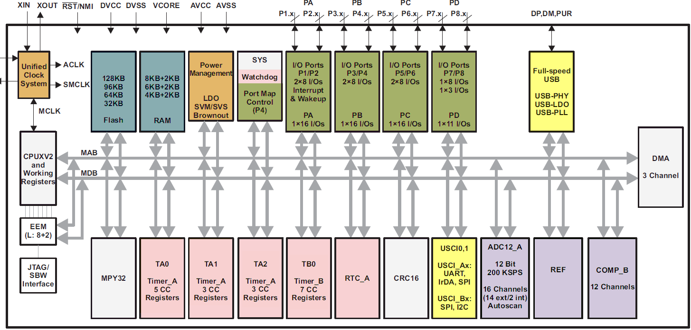
MSP430F5529 Block diagram & its Peripherals
Watchdog
Clocks
Power
GPIO
USB
Timer A & B
‘F5529 block diagram
RTC

Slide 27
MSP430 GPIO (GPIOs)
GPIO
GPIO
Independently programmable
Any combination of input, output, interrupt and peripheral is possible
Each I/O has an individually programmable pull-up/pull-down resistor
Many devices can lock pin values during low-power modes
Some devices support touch-sense capability built into the pins
‘F5529 block diagram

Slide 28
MSP430 Timers (Timers,RTC,WDT)
Watchdog
GPIO
Timers
Timer_A: 16-bit timer/counter
Multiple capture/compare registers
Generates PWM and other complex waveforms & interrupts
Directly trigger GPIO, DMA, ADC, etc.
Timer_B: Same as A; improved PWM
Timer_D: Same as B; with hi-res timing
RTC: Real-time clock with calendar & alarms – runs in LPM3 low power mode
Watch: Watchdog or interval functions
Timer A & B
‘F5529 block diagram
RTC

Slide 29
MSP430 Communication
Watchdog
Clocks
Power
GPIO
USB
Communications
USB
USB 2.0 at Full speed (12Mbps)
Includes PHY, LDO, PLL, PUR
Serial ports
USI: SPI, I2C
USCI: SPI, I2C, IrDA, UART
eUSCI: enhanced USCI
Radio Frequency
CC430 and RF430 devices include Sub-1GHz or NFC radios
WiFi, BLE, ANT, Bluetooth & Sub1GHz communications via TI SimpleLink
‘F5529 block diagram
CH 6
Timers

Slide 30
MSP430 Accelerators
Watchdog
CH 5
Clocks
Power
GPIO
C
USB
Accelerators
DMA (“hardware memory”)
Copy from memory to memory
Faster copies than with CPU
Supports periph’s (ADC, UART)
MPY32 (8/16/32 Multiplier)
MAC, fractional, saturation support
CRC: Single-cycle CRC generation
AES: 128, 192, 256 bit encryption
LCD: Automatic with up-to 160-bit
‘F5529 block diagram

Slide 31
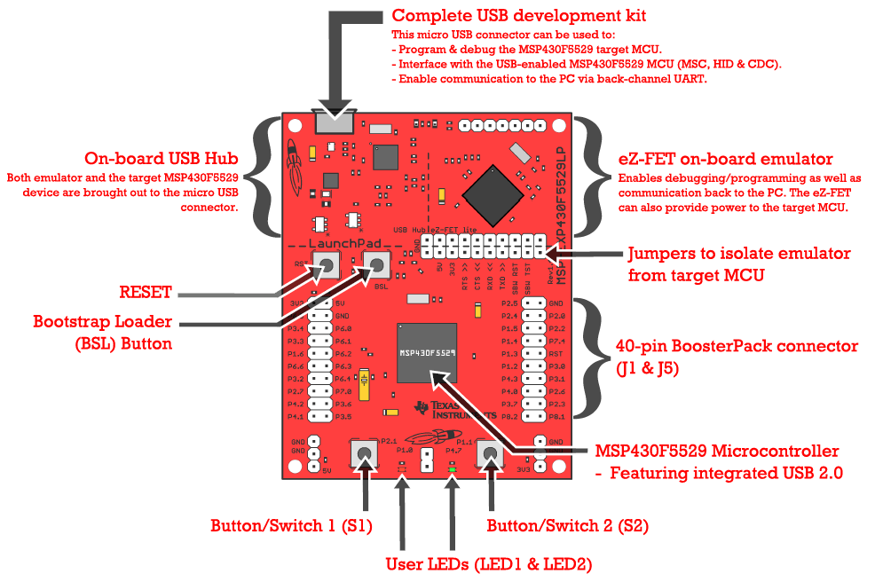
MSP-EXP430F5529LP Overview

Slide 32
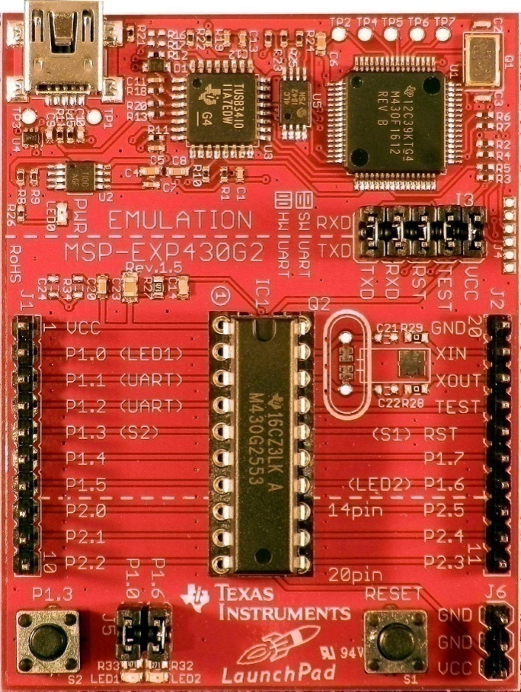
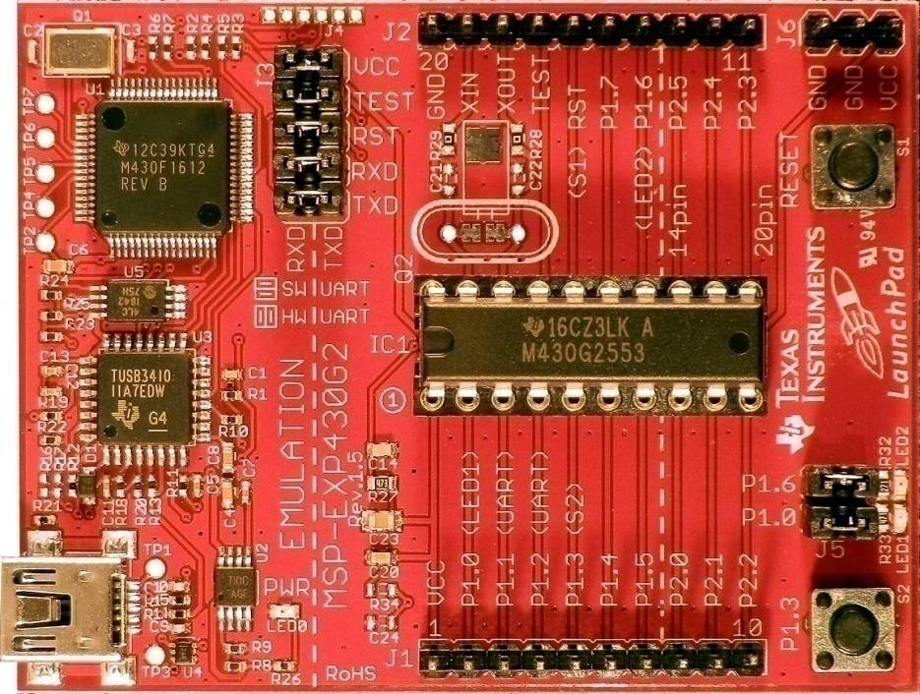
G2553 LaunchPad Development Board
USB Emulator Connection
Embedded Emulation
16kB Flash
512B RAM
2 Timer_A3’s
8 Ch. Comp_A+
8 Ch. ADC10
USCI
6-pin eZ430 Connector
Crystal Pads
Chip Pinouts
Part and Socket
P1.3 Button
Power Connector
LEDs and Jumpers
P1.0 & P1.6
Reset Button

Slide 33
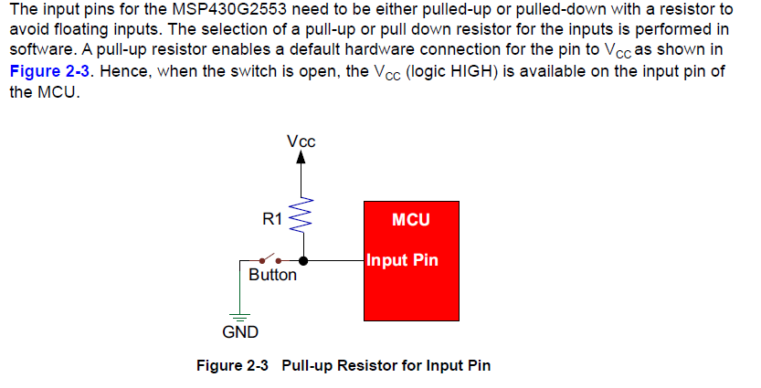
Pull-up Resistor

Slide 34
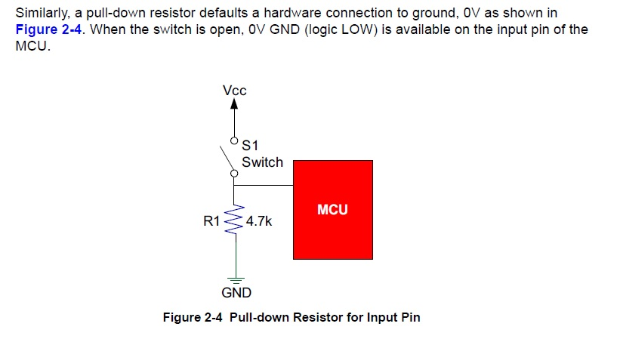
Pull-down Resistor

Slide 35
GPIO:
Independently programmable.
Any combination of input, output, interrupt and peripheral is possible.
Each I/O has an individually programmable pull up/pull down resistor.
Many devices can lock pin values during low power mode.
Some devices support touch-sense capability built in to pins.
This GPIO can consist of unified clock system and also having ACLK, SMCLK, and MCLK.

Slide 36
Timer_ A:
It is 16-bit timer/counter
Multiple capture/compare registers
Generates PWM and other complex waveforms & interrupts
Directly trigger GPIO, DMA, and ADC etc.
Timer_ B:
Multiple capture/compare registers
Generates PWM and other complex waveforms & interrupts
Directly trigger GPIO, DMA, ADC, and PWM.

Slide 37
Non maskable interrupts:
These are a few small differences in the handling of non maskable interrupts compared with the maskable type.
All the sources share a single vector, which has the highest address and therefore the highest priority except for the reset vector.
Three modules can request a non maskable interrupt.
Oscillator Faults:-
A failure of a clock,MCLK is particular links crippling.the clock module detects and recovers from the most likely fault,The failure of an oscillator relies on a vulnerable external crystal.
Each oscillator has flag which raised to indicate a fault,which also sets the OFIFG bit in interrupt flag register IFG 1.
The values are stored in segment A, of the information memory,which is locked by default against programming and erasing...

Slide 38
Frequency-Locked Loop,FLL:-
The MSP430X4XX family has more sophisticated FL++ clock module.
LFXT1 and XT2 and some more are similar to MSP430F2XX but registers and bits have different names. the load capacitance for low-frequency crystal is controlled by XCAPXPF bits in FLL-CTLO register
There are no dividers for internal clocks but the external signal from ACLK can divide.
This hardware aims to lock the frequency of DCO to LFXT1.
This intern requests a Nonmaskable interrupt if it has enable.
Its also switches MCLK to DCO if it was not already used, which ensures CPU remains active.
Users software can then take appropriate action

Slide 39
